Slide 1


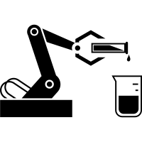



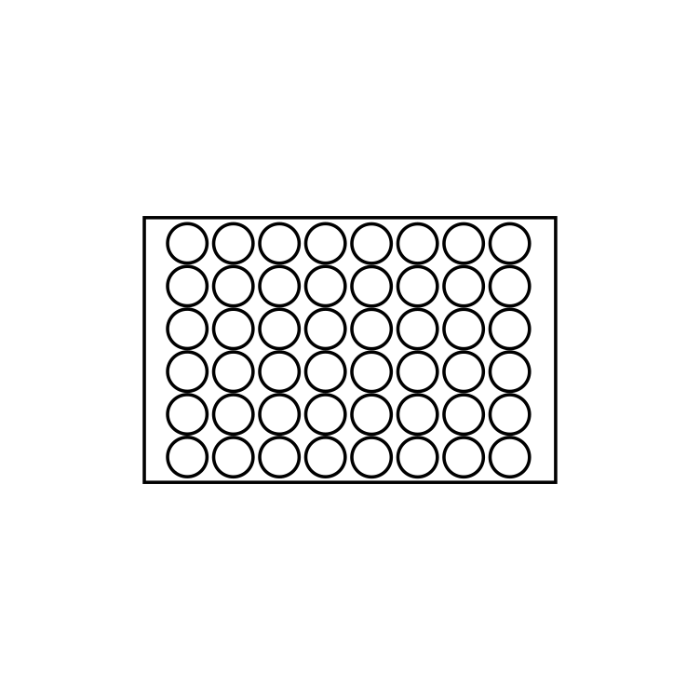
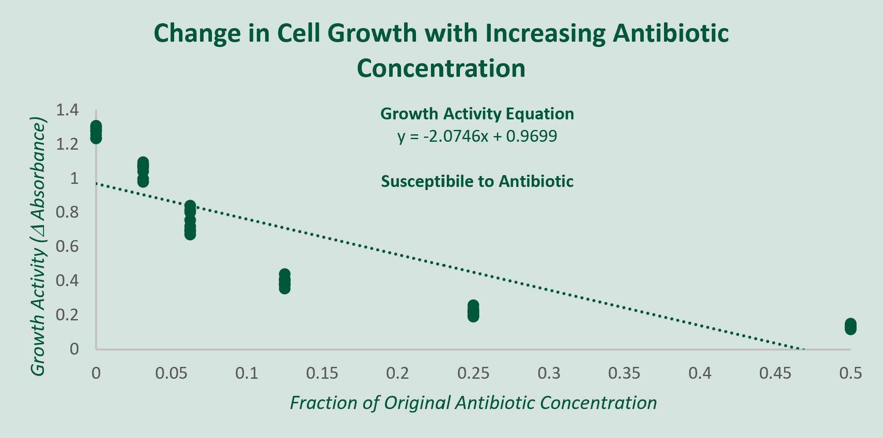
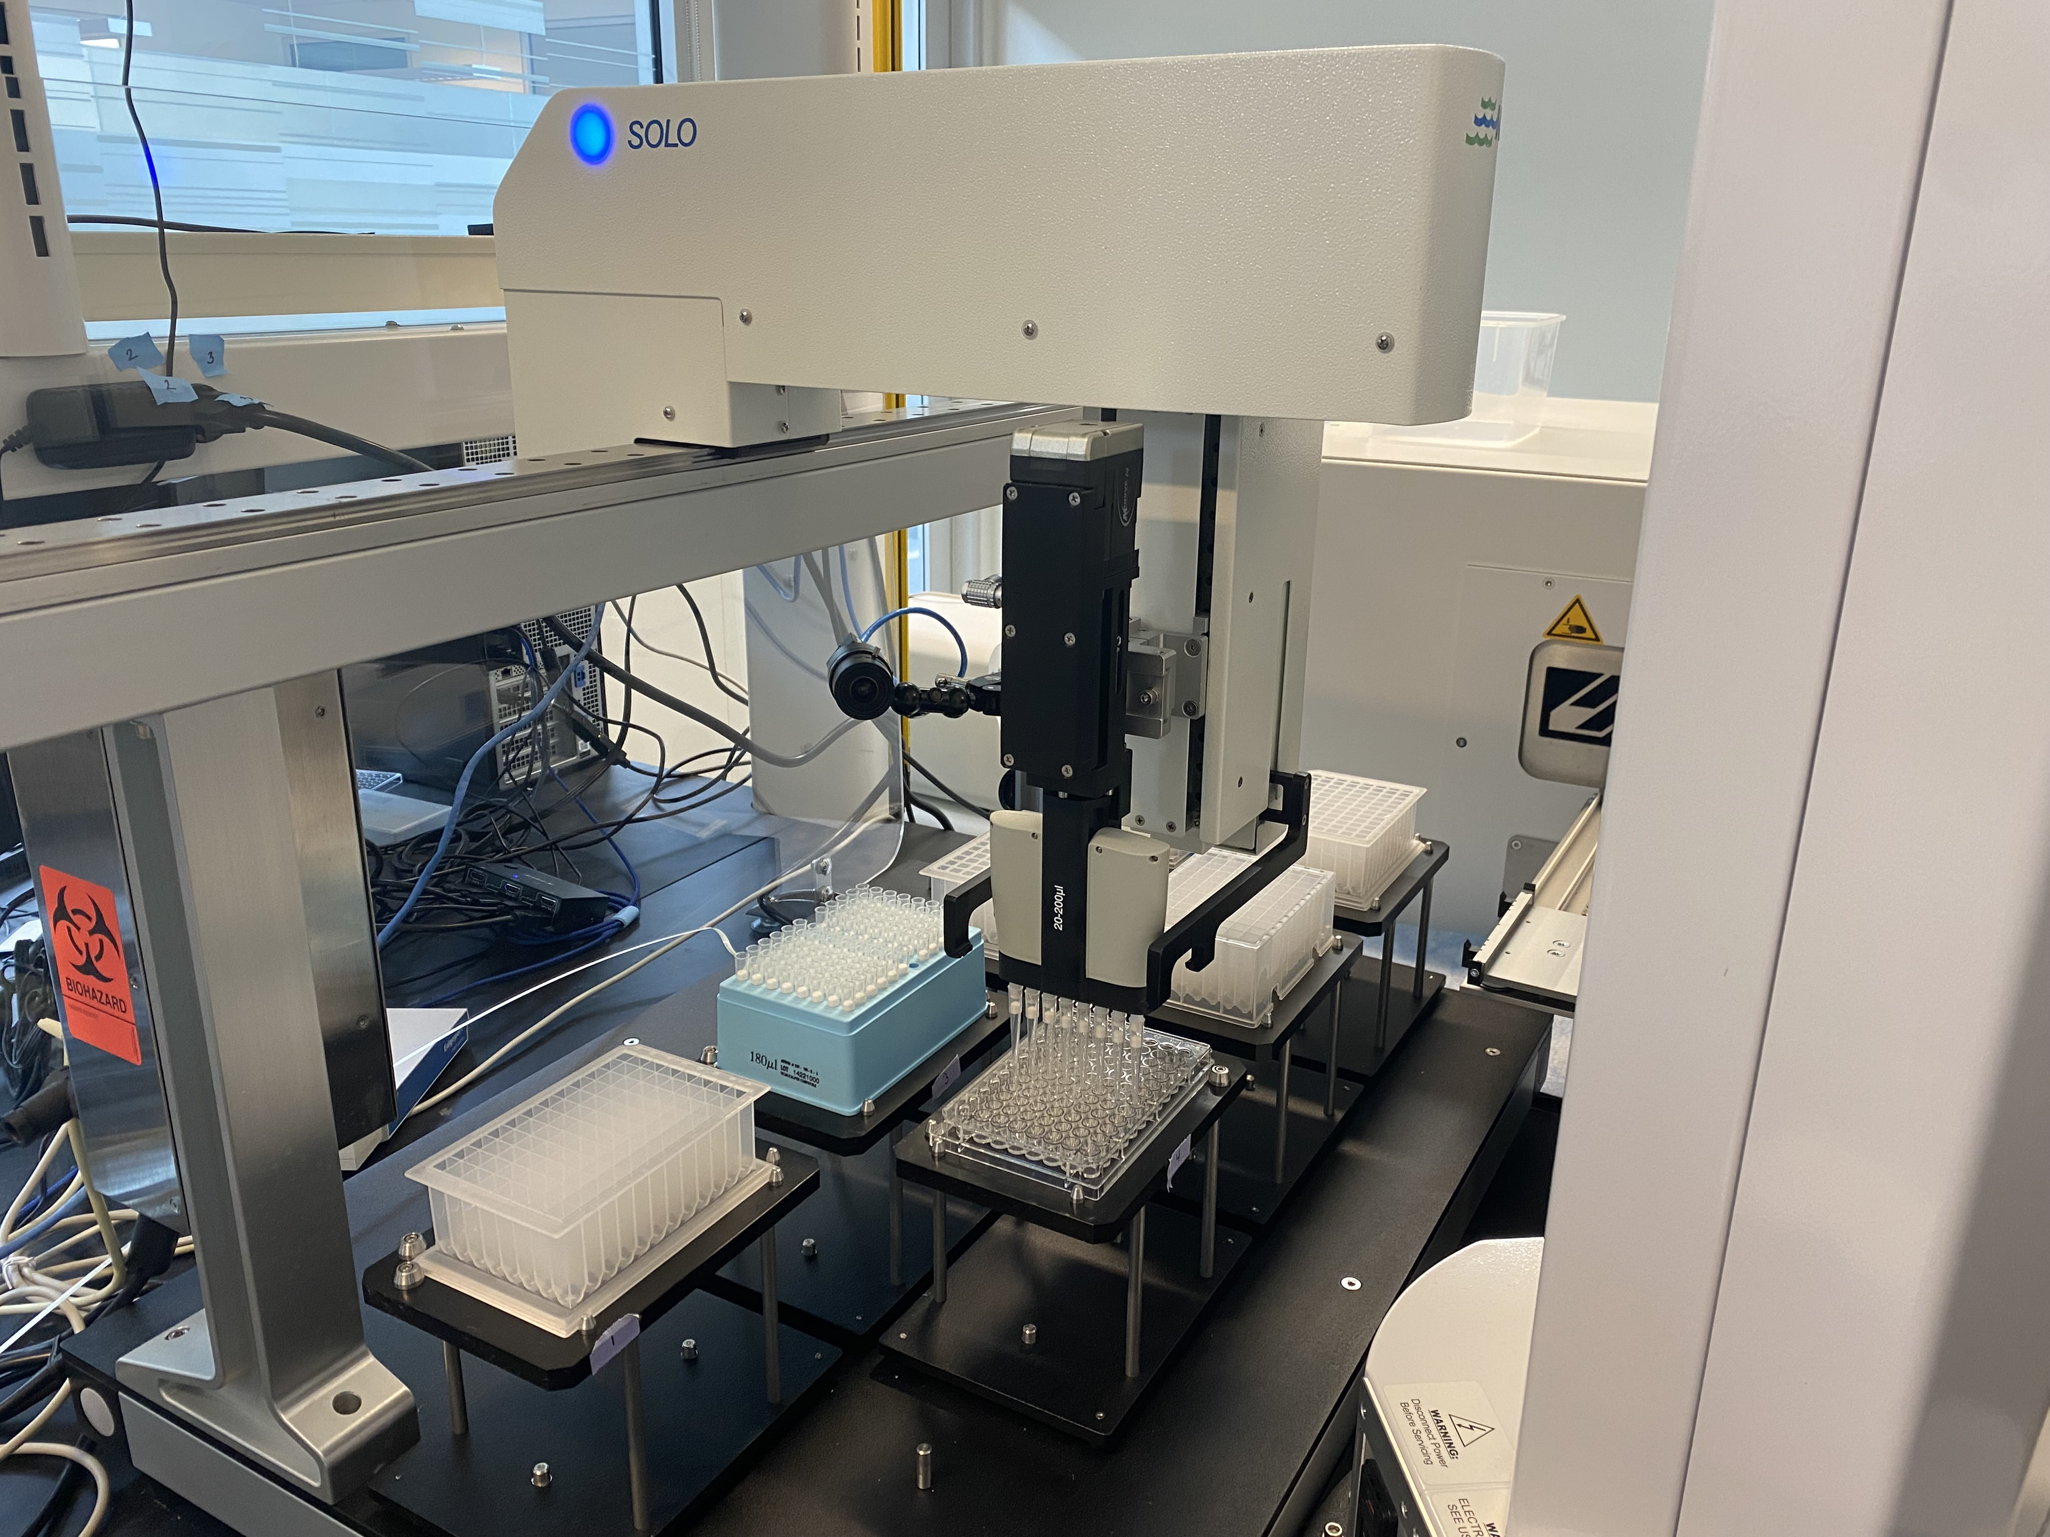
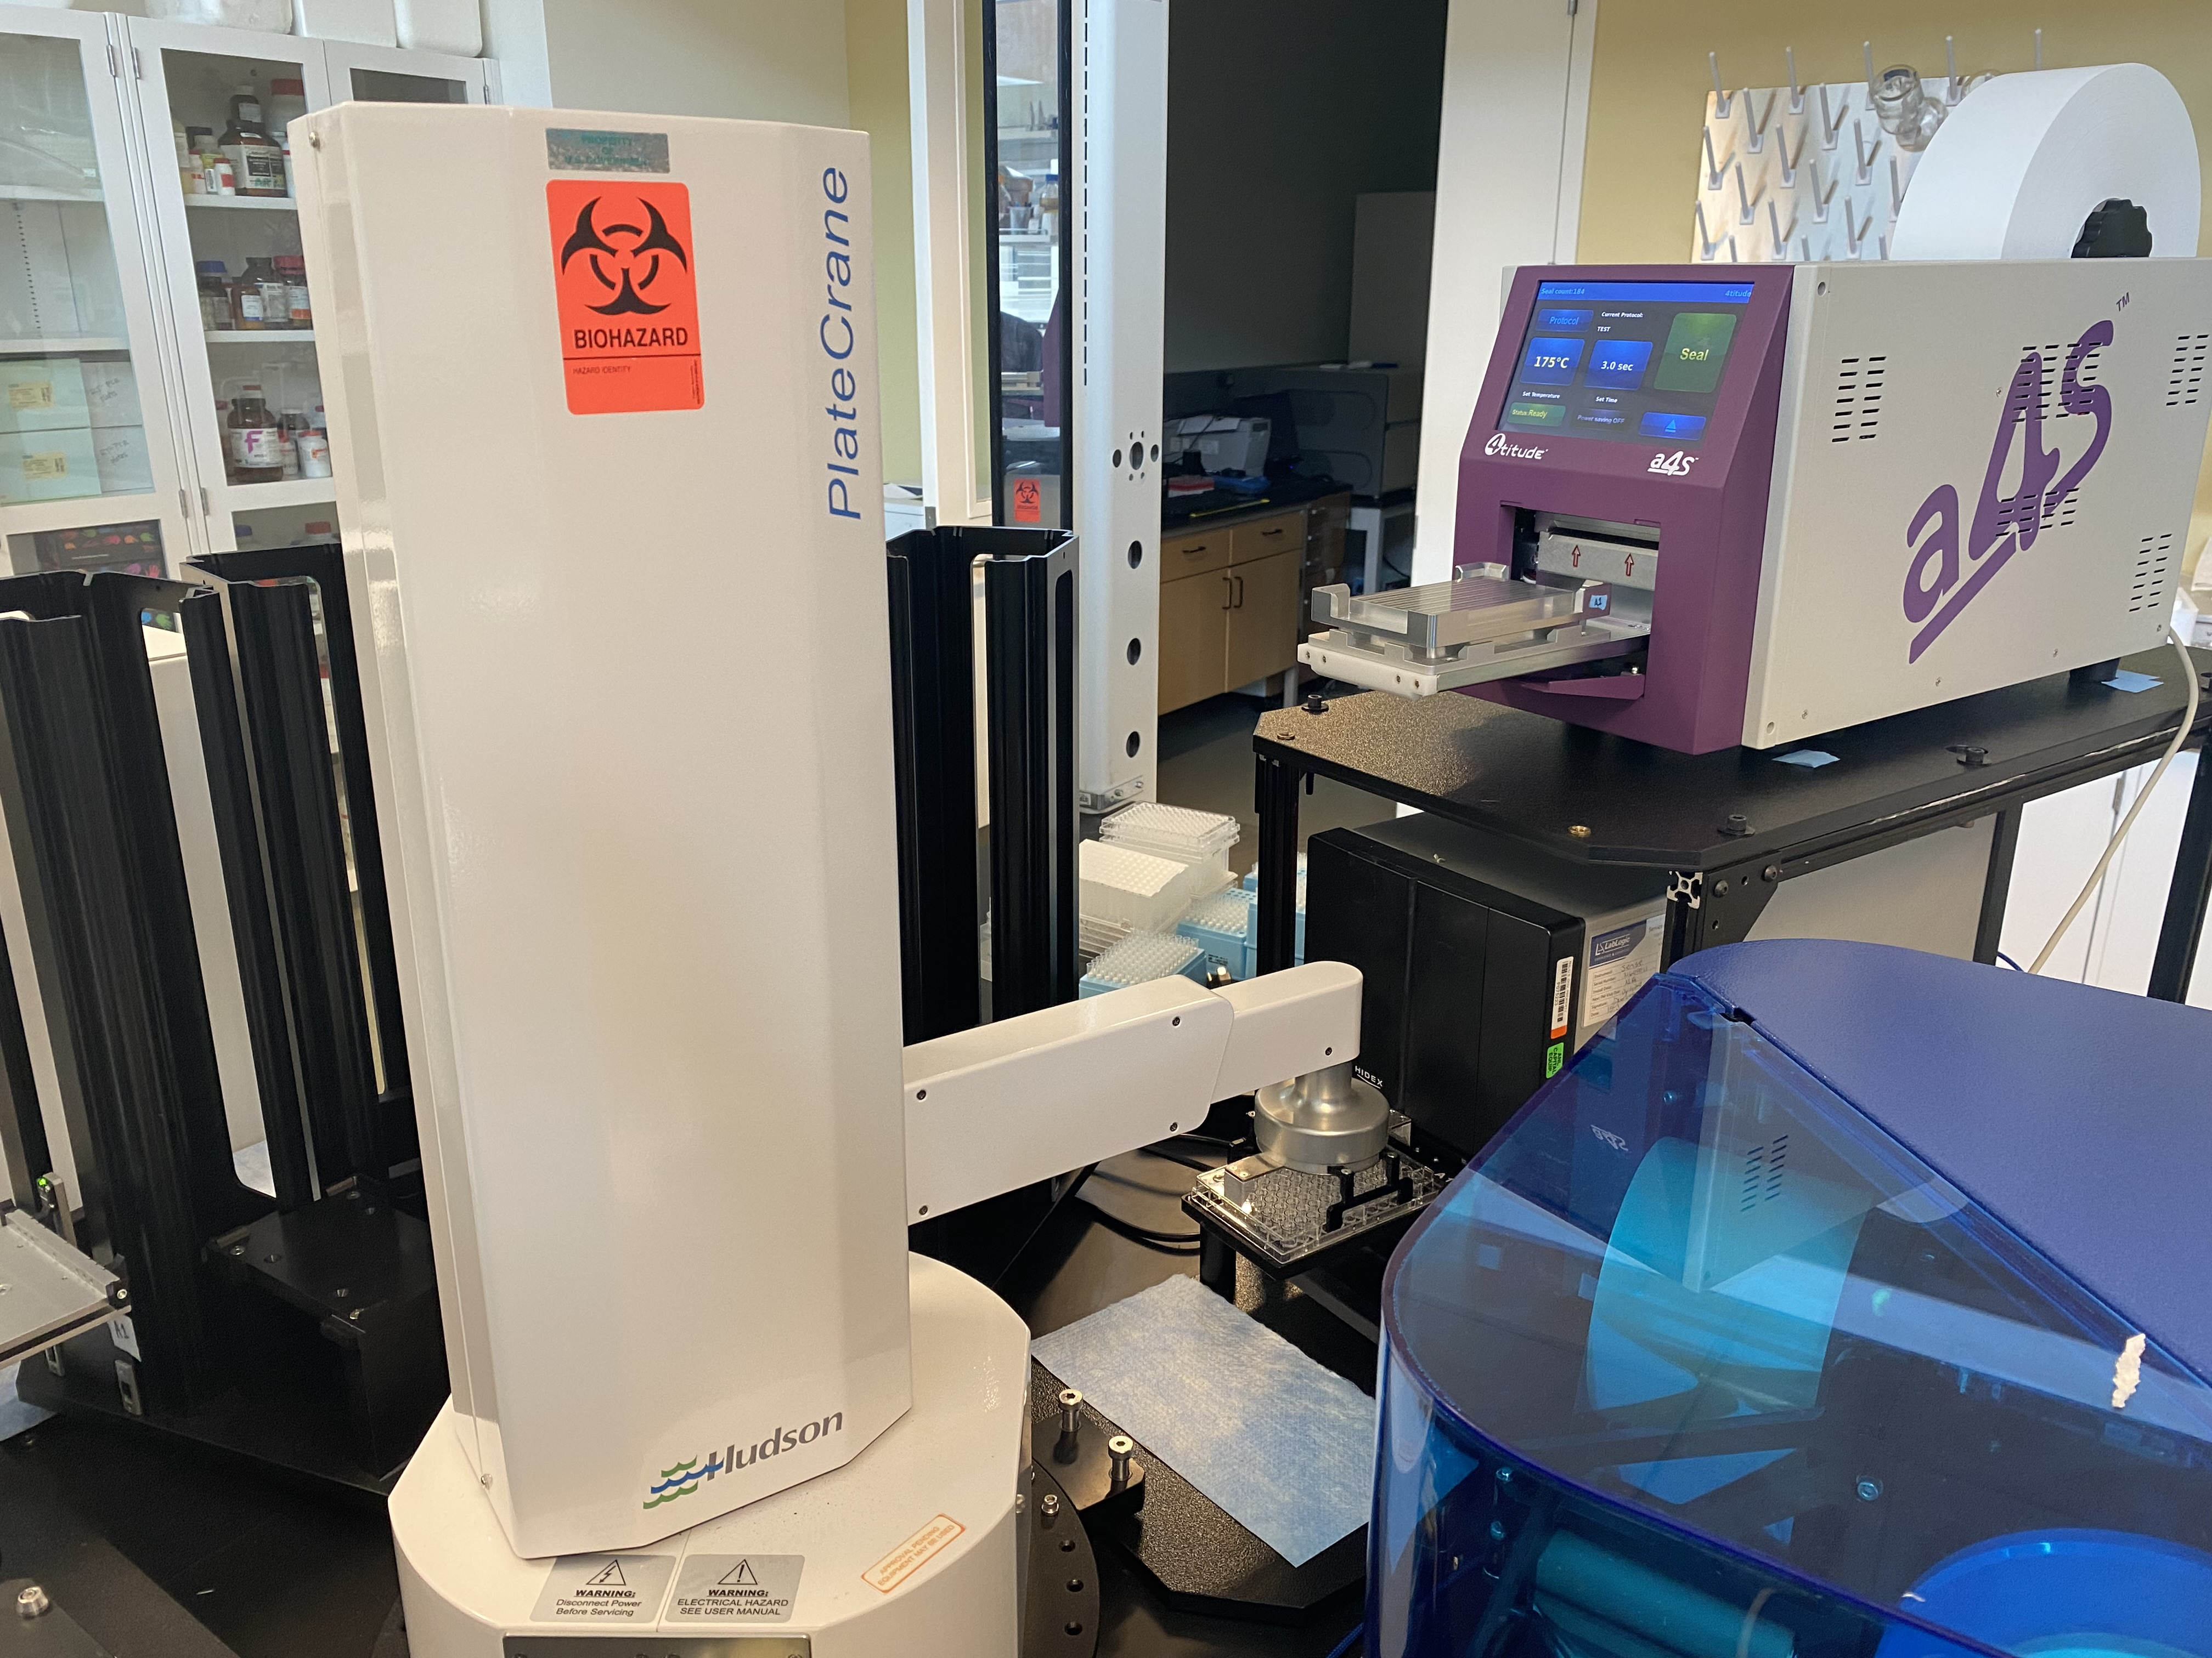
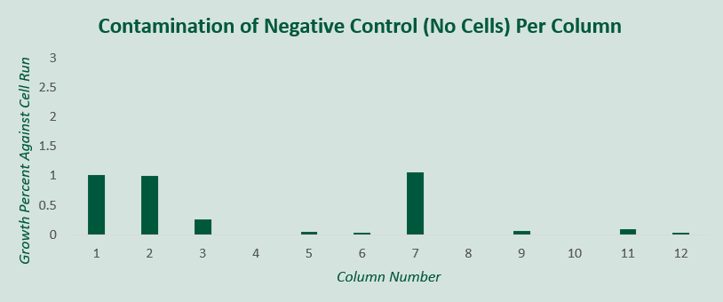
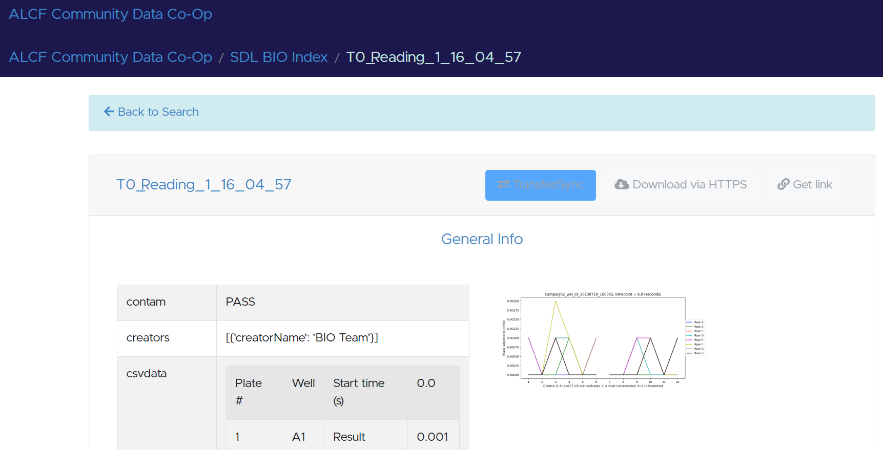
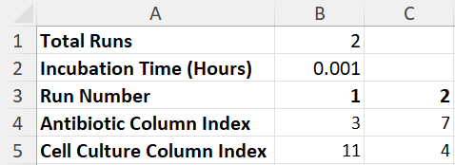
Automating growth assay To predict cell antibiotic resistance
Alp Demirtas, Abraham Stroka, Casey Stone, and Rafael Vescovi
Rapid Prototyping Laboratory, Data Science and Learning Division
Motivation: Advancements in automation can transform scientific research by allowing experiments to scale up and run continuously with AI, but only few fully-automated biological experiments have been conducted
Objective: Run a fully-automated biological growth assay experiment
Create “actions” that allow the computer to send a robot a procedure
Incorporate a list of actions to various robots in experiment workflow
Run workflows to grow cells and expose them to different concentrations of antibiotic
Gather growth data when experiment first starts and 12 hours later and upload it to global portal for scientists to read
Process data to determine if cell is susceptible to the antibiotic
Train AI model to continuously predict new experiments
Expand program & setup to incorporate up to 12 experiments per run
INTRODUCTION
Query Experiment
Update AI Model
Perform Automated Experiment
Process Data from Portal
Analyze Results
Scaled Up Protocol: Expanded program to continuously run up to 12 growth assay experiments (Objective 7) and developed logic-based workflow to set up and dispose plates (Objective 2)
Refill Pipette Tips: Created action where computer notifies Hudson Solo liquid handler that tips have been refilled for another run (Objective 1)
Hidex Plate: Debugged Hidex Plate Reader to ensure data collection 12 hours after its first reading (Objective 4)
Data Processing: Read data from Globus Portal to output Excel sheet with growth activity of cell and antibiotic combination (Objective 5)
User Input: Allowed scientists to determine experiment by importing an Excel template and tracked assay run with barcode ID (Objective 3)
AI Model: Incorporated an AI model within program that predicts cell and antibiotic concentration with lowest growth activity (Objective 6)
MAJOR ACCOMPLISHMENTS RESULTS
Hudson Solo Robot Performing Liquid Handling
PlateCrane Robot Arm Moving Plate into Hidex
Figure 1. demonstrates the change in growth activity, the difference between absorbance value at T12 and T0 readings. As antibiotic concentration increases, cell growth decreases. The cell is susceptible to the antibiotic.
Excel Submission Form to Run Experiments
Figure 2. demonstrates the growth activity of the negative control, a blank row with no cells. Since the growth activity of the blank is 1% or less than the activity of its respective column, there is minimal contamination.
Online Portal Where Results are Uploaded
FUTURE DIRECTIONS
IMPACT
Demonstrated the promise of using robots to conduct biological experiments
Minimal contamination in plate delivers reliable results
Experimental program is not limited by time constraints
Program can accommodate more plates with more storage room
Artificial Intelligence models can be run within the program to determine antibiotic combinations that will make a cell most susceptible to the drug
Automating new protocols is easier because underlying robot actions and program structure are the same
Implementing the growth assay automated workflow as a service for biological researchers at the Argonne National Laboratory
Developing the programming application to be easy to use for researchers with a graphic interface
Automate other biological experiments such as Golden Gate DNA cloning
Incorporate a feature for the program to track the growth of cells every hour, not just 12 hours after the first reading
Allow for the Hudson Solo liquid handling protocol to dilute antibiotic and cell concentrations as specified by the researcher, not just factors of 2
Dama et al., BacterAI maps microbial metabolism without prior knowledge 2023

